Slide 1
Final Project DS-DC-14
Galina Solovyeva

Slide 2

Project outline
Dataset - Expedia Hotel Recommendations on Kaggle Fri 15 Apr 2016 – Fri 10 Jun 2016
Dataset contains logs of customer behavior:
which channel was used,
how they interacted with search results (click/book),
whether or not accessed the site via mobile device
whether or not the search result was a travel package.
Competition goal – prediction which hotel group a user is going to book, based on their search and other attributes associated with that user event.

Slide 3
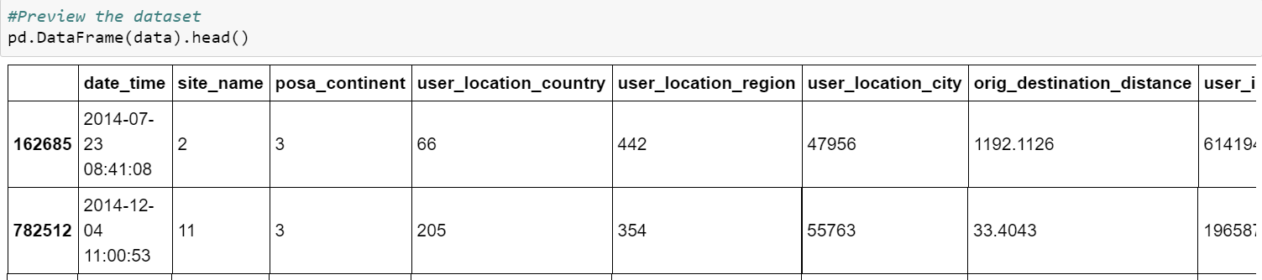
Summary
Expedia provided train and test dataset and additional file with destination attributes.
Train dataset came as 511mb zip file which contained over 37M rows.
Sampled down to 1%, shape 376707 X 24 columns
Two versions of dataset:
first kept half empty distance variable, added check in year and month, dummies for hotel country and user continent
second with calculation of two additional variables (booking window, length of stay)

Slide 4
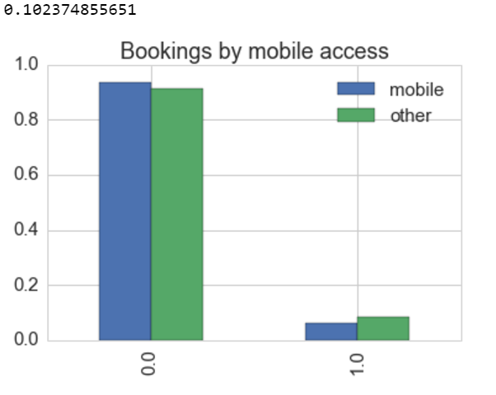
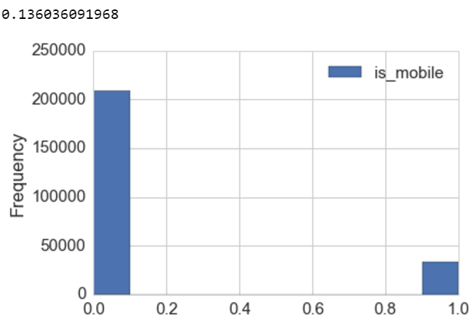
Mobile access
Are customers who access Expedia via mobile app more likely to make a booking than customers who look at a regular website.

Slide 5
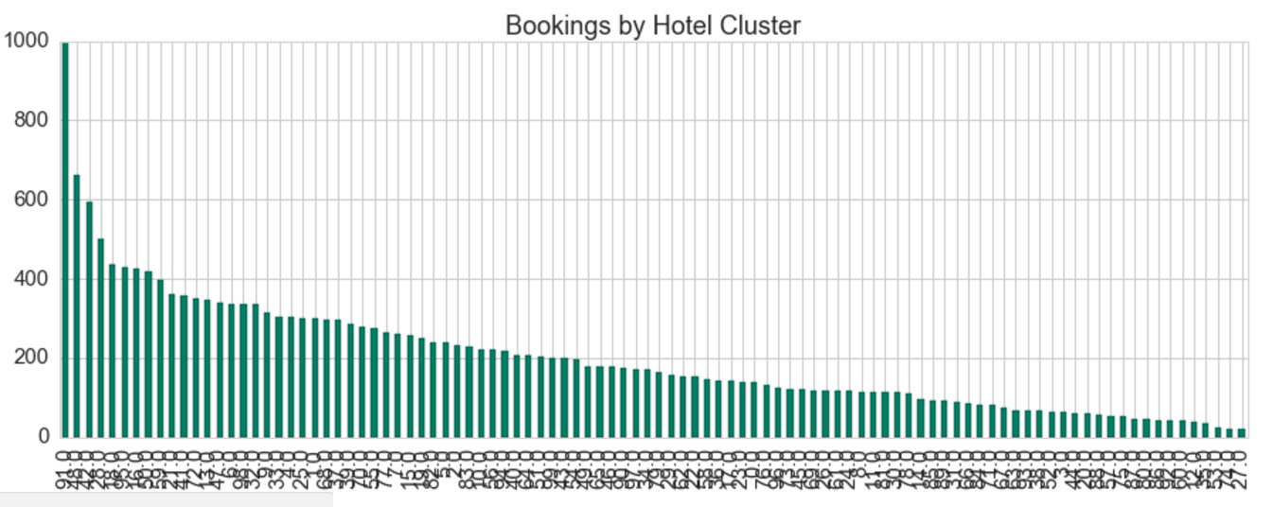
Hotel cluster prediction
Make prediction which hotel cluster Expedia customers are going to book.
100 hotel clusters
Variation across user and hotel continent, user and hotel country

Slide 6
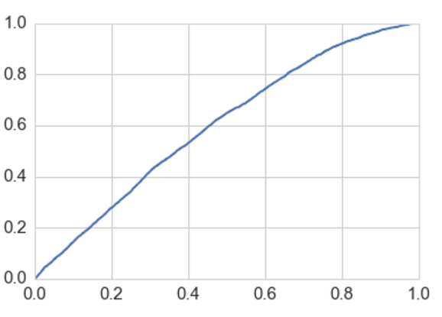

Mobile
Logistic Regression
AUC score 0.599
X = distance, package, mobile
Y = booking outcome (0/1)

Slide 7
Hotel cluster prediction
Stochastic Gradient Descent
Data Frame 1:
X = Year, distance, Month, children count, package, mobile
Accuracy score: 0.033
Data Frame 2:
X = booking window, length of stay, package
L1 regularization
High coefficient for booking window
Accuracy score: 0.018

Slide 8
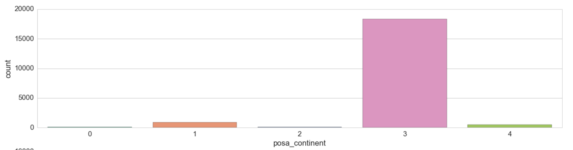
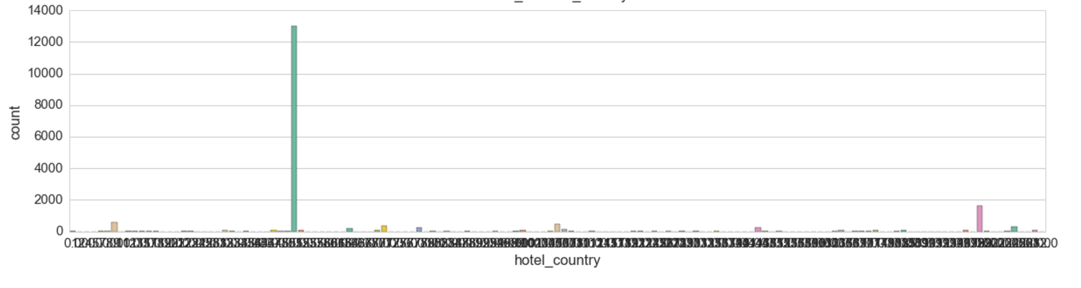
Hotel cluster prediction
Logistic Regression
Data Frame 1:
Dummies – hotel country and user continent
X = distance, children count, Year, Month, package, mobile, hotel_country_50.0, 198, 8, 105, 70, user continent 2,3,4
Accuracy first run: 0.55
Accuracy: 0.07

Slide 9
Hotel cluster prediction
Random Forest
Feature Optimization
Data Frame 1:
First run on the whole dataset
Accuracy 0.115
Various feature combinations
Best Accuracy score: 0.160
features = hotel continent, hotel market, search destination, hotel country 1-198
Expedia description:
“hotel clusters, where similar hotels for a search (based on historical price, customer star ratings, geographical locations relative to city center, etc.”

Slide 10
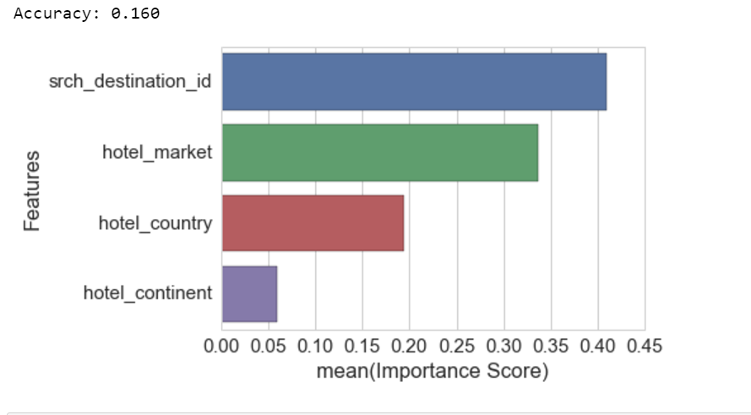
Results
Grid Search for number of estimators
n_estimators = 200
Final model:
rf = ensemble.RandomForestClassifier(n_estimators=50, min_samples_leaf=5).fit(X_train,y_train)

Slide 11
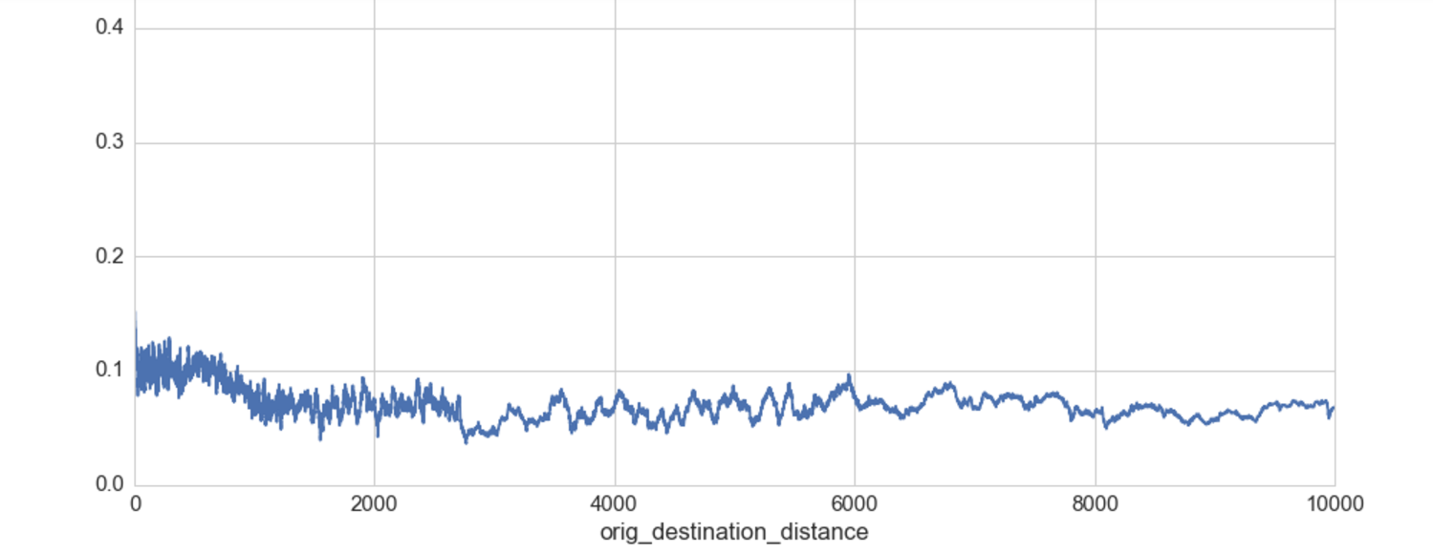
Conclusion
Winning solution
Beginner approach
Further look into variables that affect booking outcome

